Slide 1


Disrupting Medicine using
Electronic Medical Records
Uri Kartoun PhD
Center for Computational Health
IBM Cambridge Research Center
March 2019

Slide 2
Schedule
Guest lectures
Florence, an IBM Master Inventor and a senior architect, will share her extensive experience in inventing.
FX will share of his extensive experience as a physician, working also for start-ups and with IBM Research and Watson Health.
Yoonyoung, a Harvard graduate, will give an introductory overview of a variety of statistical approaches.
Use the “Right Heart Catheterization Dataset” made available by Vanderbilt university
Team 1: Is “right heart catheterization” beneficial to patients? Is it beneficial to certain patients but harmful to others?
Team 2: Is “right heart catheterization” beneficial to patients? Explore “confounding” (one of the most common biases in observational databases).
Introduction to R using EMRBots
Introduction to electronic medical records
What are EMRs and what is valuable about them? Go through several use cases.
March 5
March 7
March 12
Next lectures
Disrupting medicine using electronic medical records

Slide 3
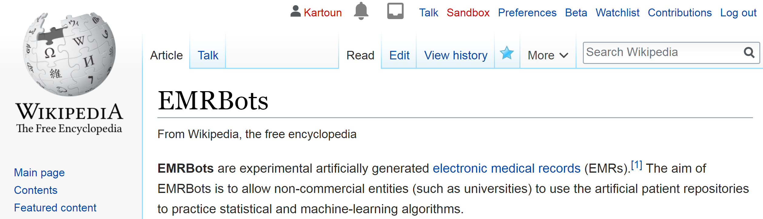
What are EMRBots?
Motivation: only a small number of individuals are given permission to access EMRs.

Slide 4
The history of EMRBots
Dedicated a weekend
to develop artificial
EMR databases
Use in our IBM & HMS
workshop
Joined
MGH / HMS
Unrestricted public
availability
May 2013
March 2014
April 2015
March 2019
Failed attempts
to monetize
Allow anyone to improve computational skills using “EMRs”

Slide 5

You Have 0 Friends
Kip Drordy

Slide 6
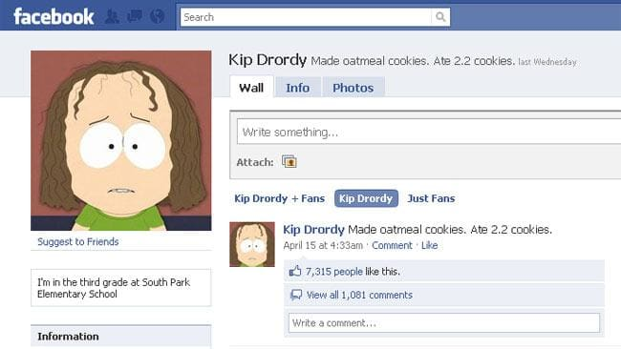
Kip Drordy is becoming more popular…

Slide 7

A show about nothing
GEORGE: Everybody’s doing something, we'll do nothing. JERRY: So, we go into NBC, we tell them we’ve got an idea for a show about nothing. GEORGE: Exactly. JERRY: They say, “What’s your show about?” I say, “Nothing.” GEORGE: There you go. (A moment passes) JERRY: (Nodding) I think you may have something there.

Slide 8
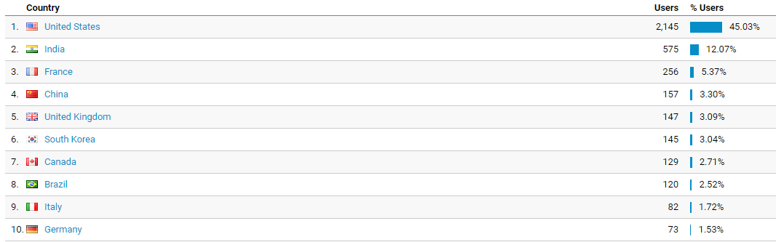
Who uses EMRBots?
April 1, 2015 to current: ~10K unique users.

Slide 9
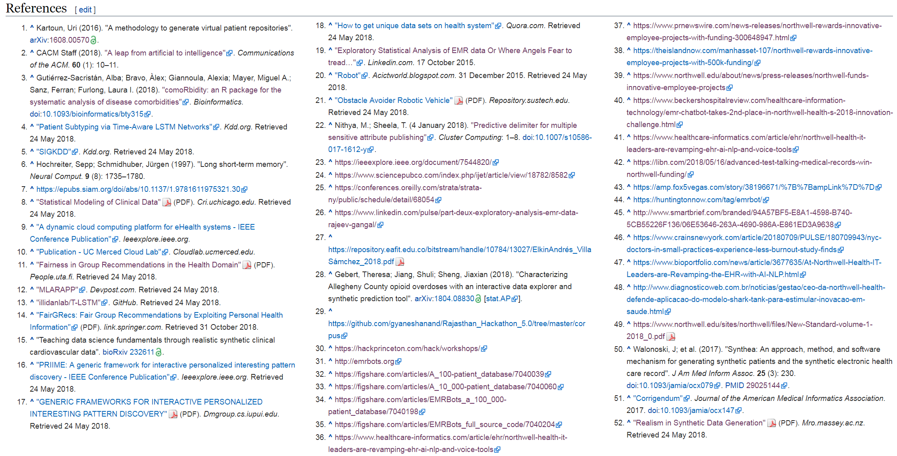
What users of EMRBots have achieved?
For example, the repositories have been used to:
Develop a neural network [Baytas et al., 2017].
Advance teaching [Mayampurath and Johnson, 2018].
Enhance student dissertations [Bhuiyan 2016].
Facilitate hackathons [Gebert et al., 2018].
Produce new R packages [Gutiérrez-Sacristán et al., 2018].

Slide 10
Use EMRBots
Let’s practice R
using simulated EMRs
https://github.com/kartoun/IBM-Harvard-Workshop
Notes:
https://www.youtube.com/watch?v=SvExPAHT_TM

Slide 11
How can I get the repositories?
See “Availability” under:
https://en.wikipedia.org/wiki/EMRBots
A 100-patient, 10,000-patient, and 100,000-patient databases are available to download.
Full source code is available to download as well.

Slide 12
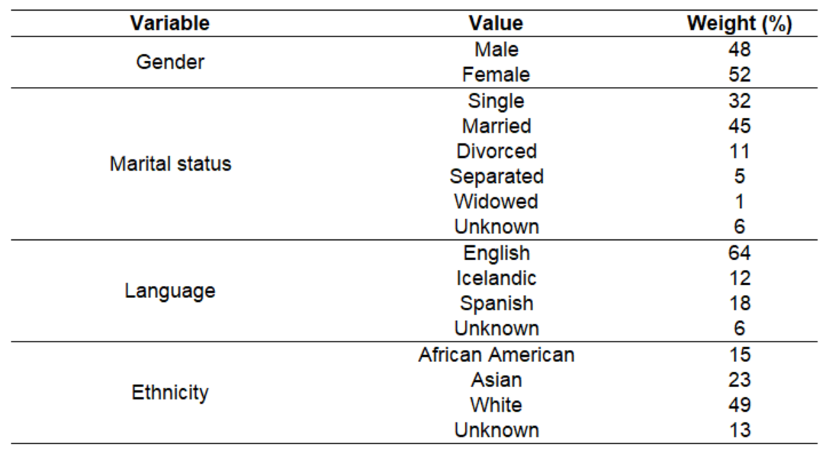
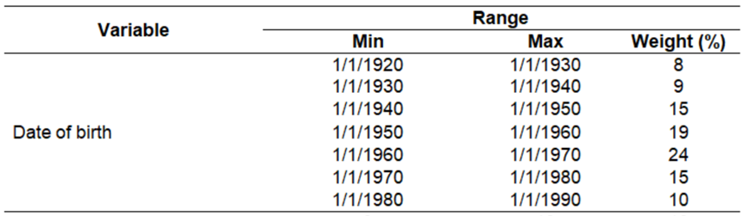
What is an EMR bot?

Slide 13
How bots are created?
Date of birth
(July 4 1948)
A first admission
A second admission
Primary diagnosis:
“Heart failure, Left ventricular failure”
(ICD-10: I50.1)
Primary diagnosis:
“Alcoholic fatty liver”
(ICD-10: K70.0)
Admitted
(March 8 2012)
Discharged
(March 19 2012)
Admitted
(October 29 2016)
Discharged
(November 6 2016)
Laboratory
measurements
Laboratory
measurements

Slide 14
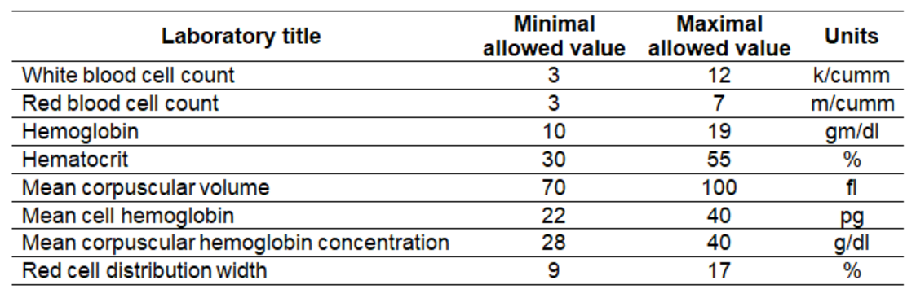
What lab types and values are used?
A total of 26 lab types.

Slide 15
Are there good tutorials that actually demonstrate how to use EMRBots?
Yes!
Mayampurath A, Johnson J.
Statistical modeling of clinical data.
Center for Research Informatics at the University of Chicago.
http://cri.uchicago.edu/wp-content/uploads/2018/02/CRI_StatisticalModeling_Methods.pdf

Slide 16
An exercise: what factors are associated with an admission primarily to cancer?
10,000 patients
36K admissions
Outcome: cancer / no cancer
Covariates: labs, demographics, length of stay, etc.
Use logistic regression to assess the contribution of each covariate relative to the outcome.
Notes:
https://stats.stackexchange.com/questions/190763/how-to-decide-which-glm-family-to-use

